Slide 1
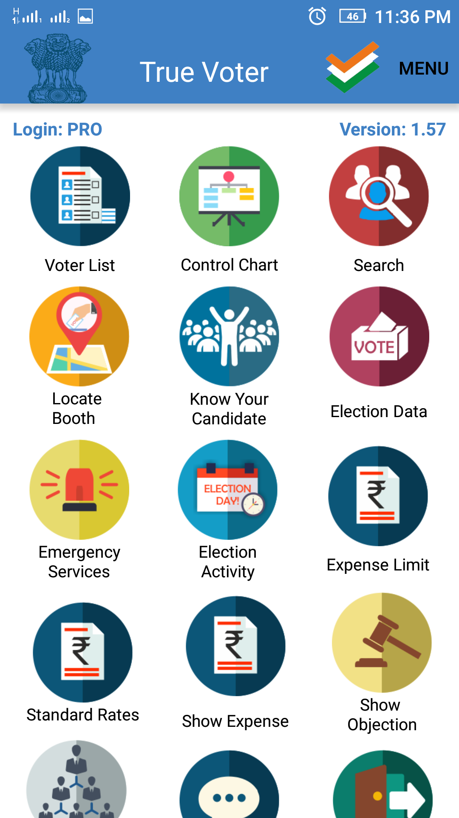
True Voter version 1.57
Election Activity:-
In this function officer user can keep entry about preparation of booth at the time of election day.
In officer role ‘PRO’, ‘PO1’, ‘PO2’, user can access this function.
Click on ‘Election Activty’ button on the officer login screen.

Slide 2
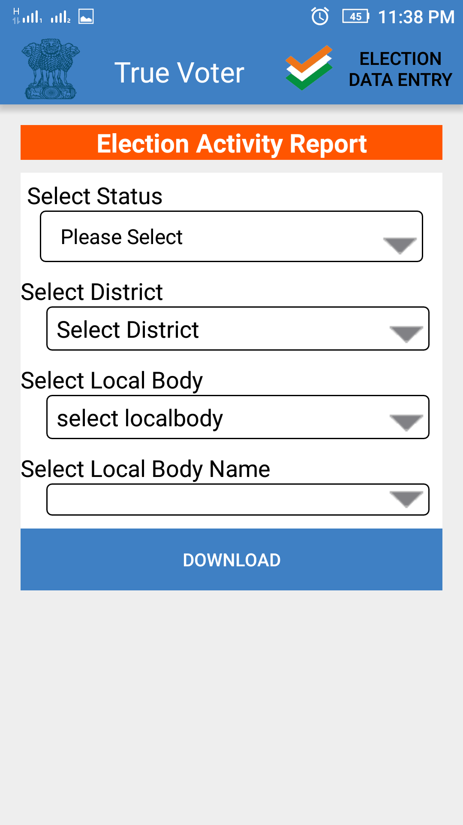
True Voter version 1.57
User will displayed the Election Activity Report’ page.
To use election activity functiom click on the ‘Election Data Entry’ option on the header.
‘Election Activity’ form will be displayed on the screen of user.
User has to enter the details as given in the form.

Slide 3
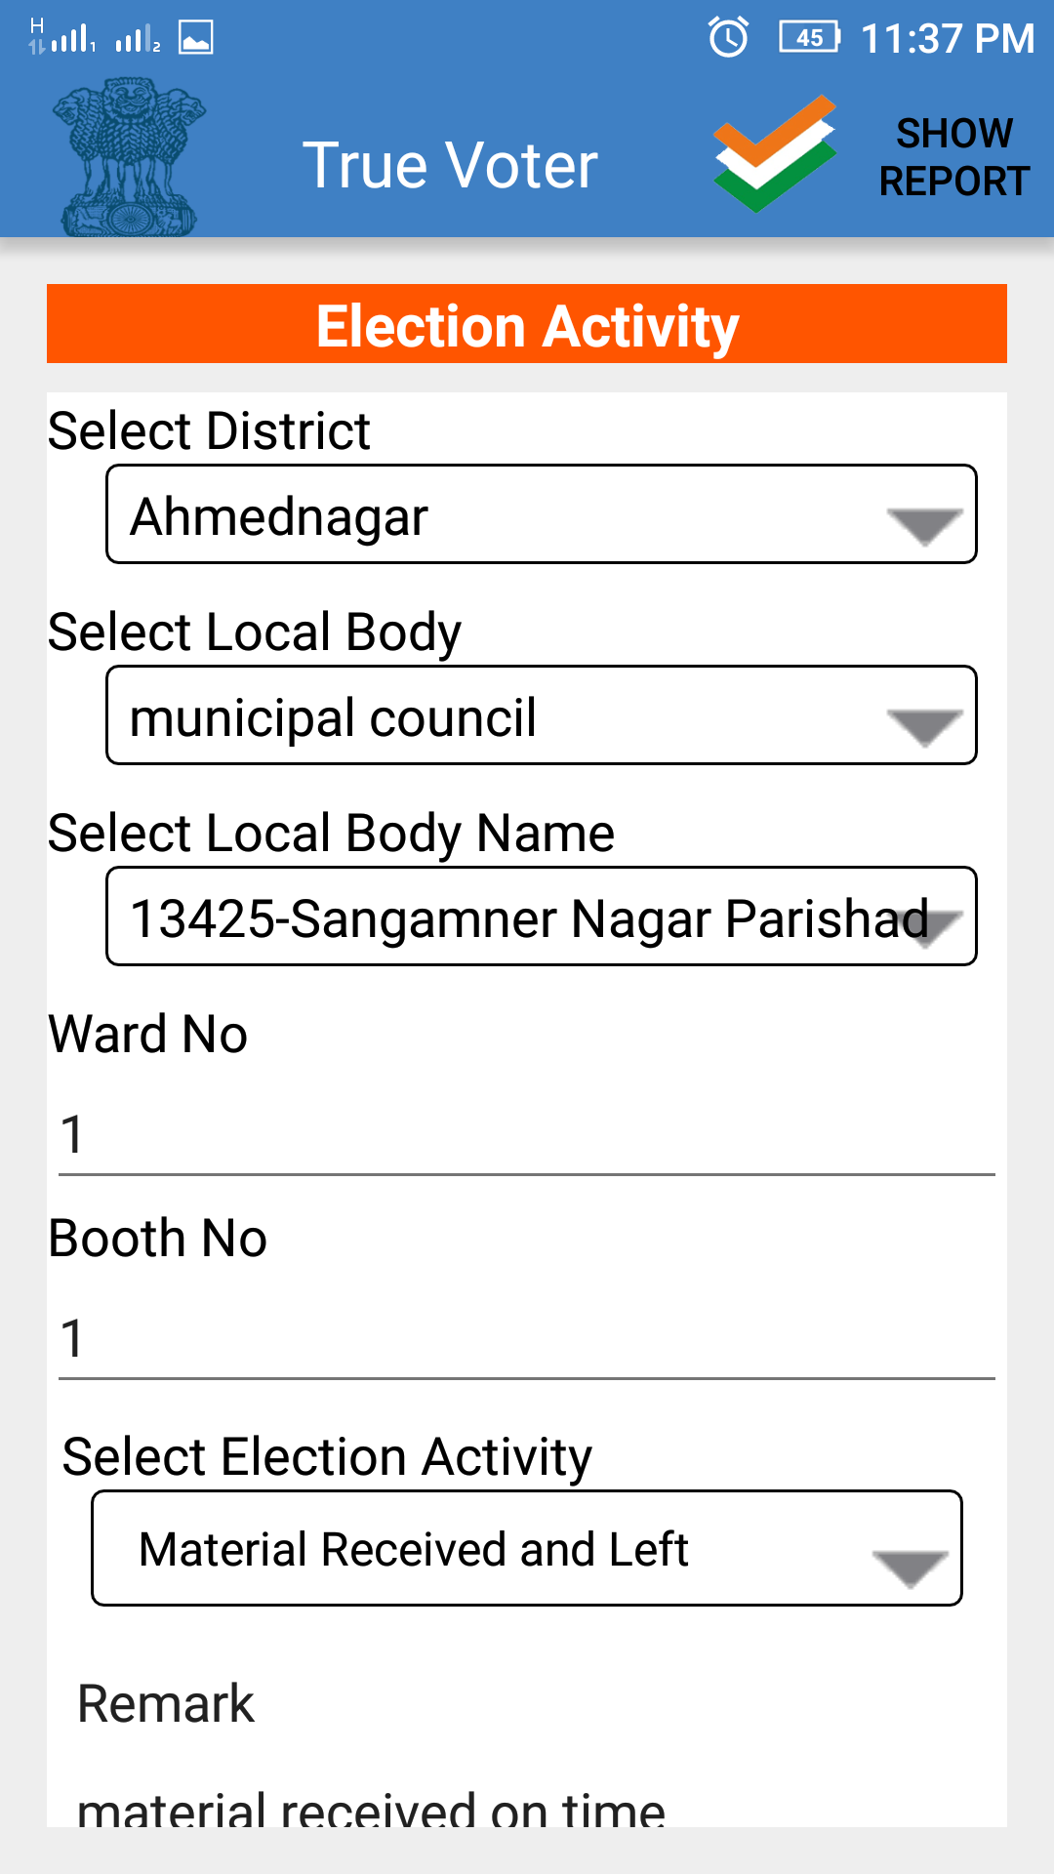
True Voter version 1.57
Select District from given list.
Select Local body type.
Select Local body name from given list.
Enter ward number
Enter Booth number
Click on ‘Select Election Activity’ to view list of election activities.

Slide 4
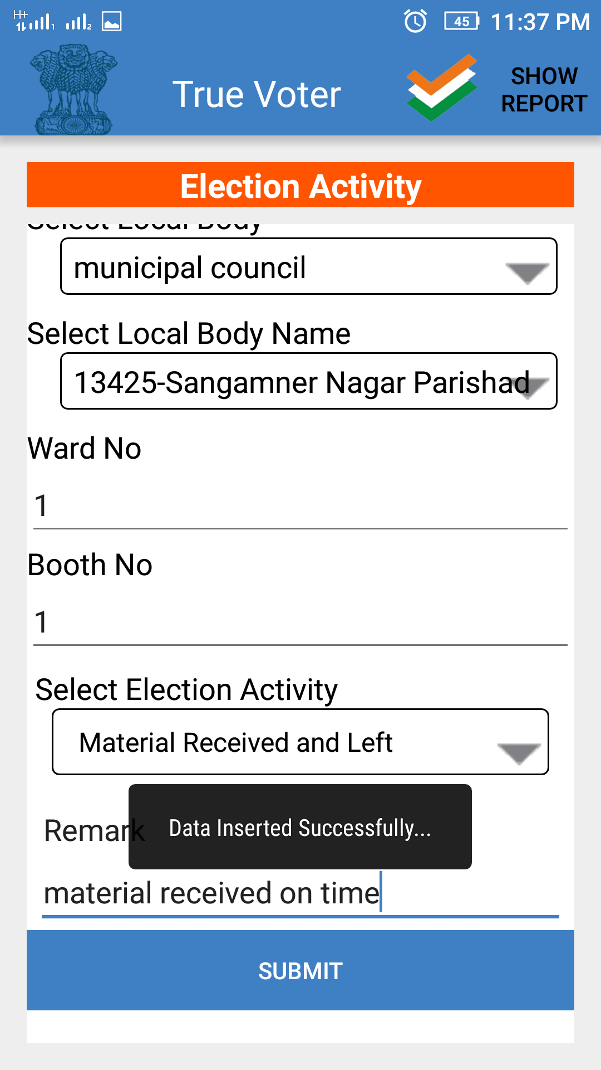
True Voter version 1.57
Select type of election activity from given list.
Enter short remark related to the election activity.
Click on ‘Submit’ button to save data.
User will get meassage that ‘Data Inserted Successfully’.
To view the report for entered record click on ‘Show Report’ option on header of screen.

Slide 5
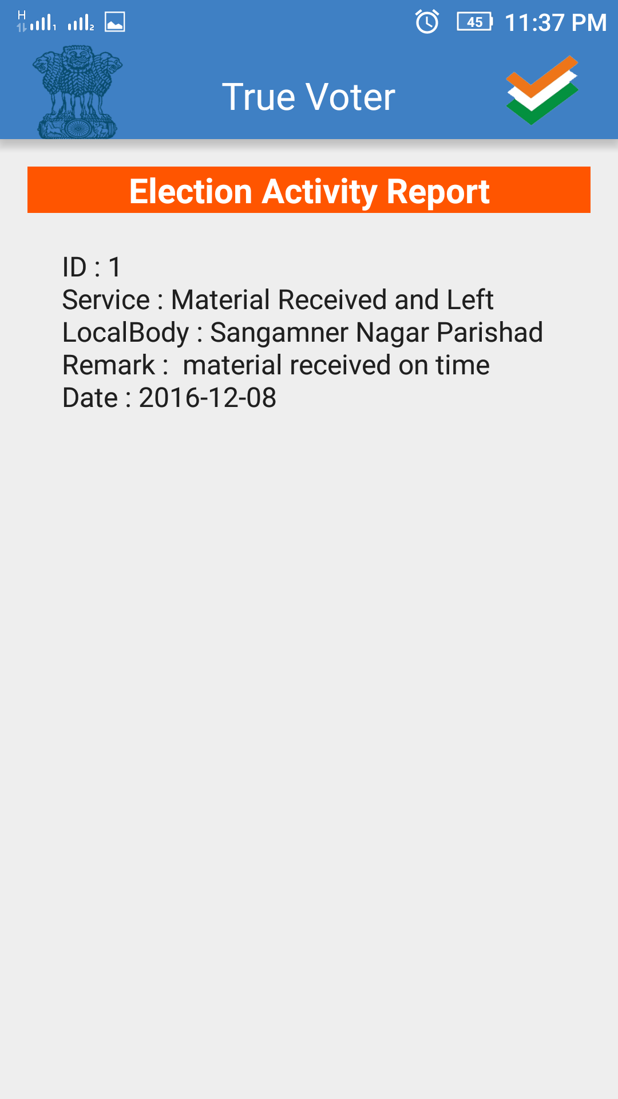
True Voter version 1.57
User will be displayed report for the election activity report as shown in the image.

Slide 6
True Voter version 1.57
To view the report for the election activity click on the ‘Election Activity’ button on the screen.
User will displayed the Election Activity Report’ page.

Slide 7
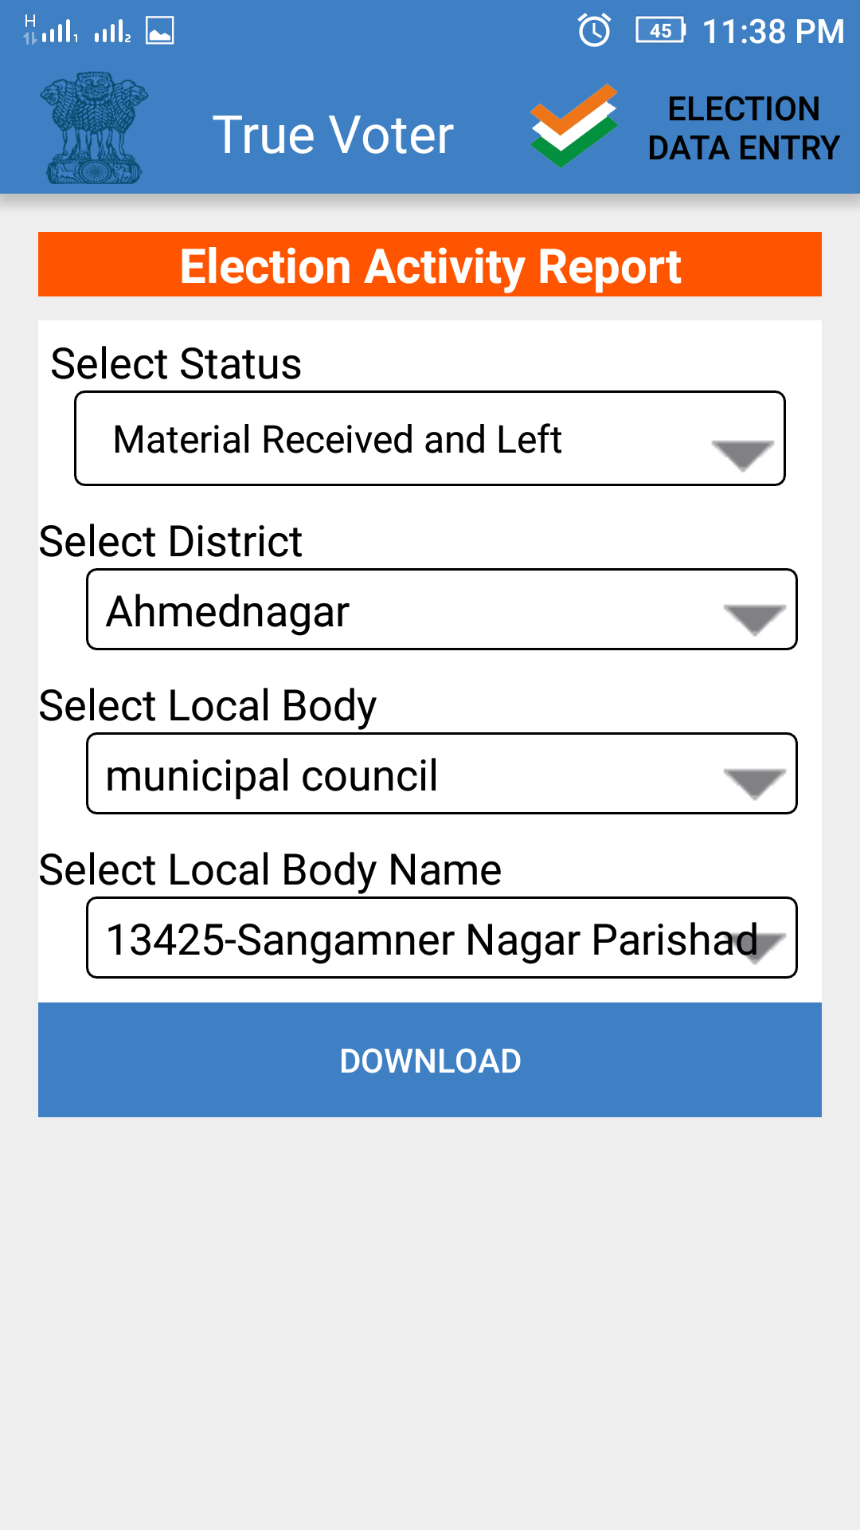
True Voter version 1.57
Select Status form the given list for which user wants to download the report.
Select district from the given list.
Select local body type.
Select local body name from the list.
Click on ‘Download’ button to download the report.

Slide 8
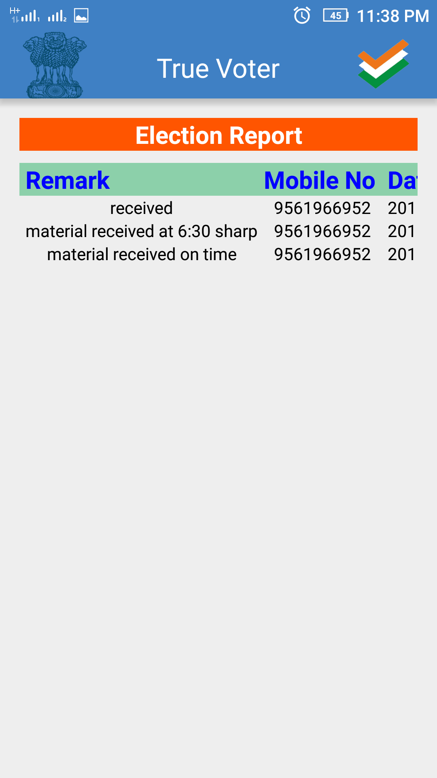
True Voter version 1.57
Report for the user entered entry for election activity will be displayed as shown in the image.

